Slide 1
8.如何继续学习
▲7.基于R和Spark的大数据分析
▼9.习题

Slide 2
继续学习建议
▼专题【案例与实践】
►8.如何继续学习
学好本章的重要意义
数据科学是一门实践性很强的学科（详见“第一章 基础理论”中的数据科学的三个要素原则），从实践中来，并有实践驱动其持续发展。因此，加强对数据科学实践的学习不仅有助于我们全面理解数据科学的特殊属性和核心理念。
继续学习方法
数据科学有三个基本要素，即理论、实战和精神。如何真正做到这三种不同要素的融会贯通是学习数据科学的高级目标。在后续学习中也应重视这三个要素的有效融合。
提醒及注意事项
R或Python编程并不是数据科学实践的目标，更不能代表数据科学实践的全部，而只是一种快速入门的技术手段——通过R或Python编程可以更好地理解数据科学的理论与精神。
与其他章节的关系
本章为其他章节中提出的数据科学理论、方法和技术的综合应用。

Slide 3
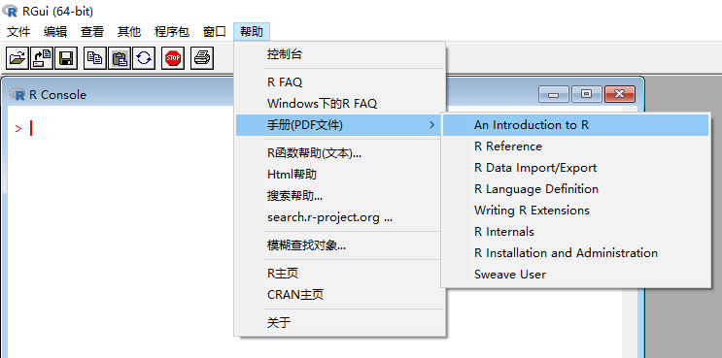

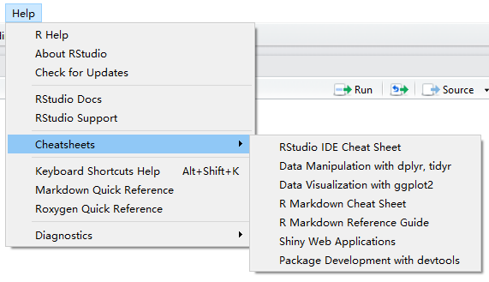

经典文献选读
▼专题【案例与实践】
►8.如何继续学习

Slide 4

经典文献选读
▼专题【案例与实践】
►8.如何继续学习

Slide 5
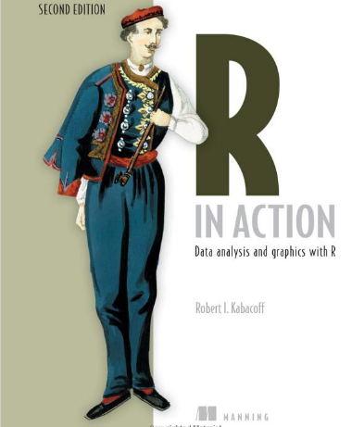
经典文献选读
▼专题【案例与实践】
►8.如何继续学习
PART 1 GETTING STARTED
Introduction to R /Creating a dataset / Getting started with graphs/Basic data management /Advanced data management
PART 2 BASIC METHODS
Basic graphs/ Basic statistics /
PART 3 INTERMEDIATE METHODS
Regression /Analysis of /Power /Intermediate graphs /Resampling statistics and bootstrapping
PART 4 ADVANCED METHODS
Generalized linear models / Principal components and factor analysis /Time series/ Cluster /Classification /Advanced methods for missing data
PART 5 EXPANDING YOUR SKILLS
Advanced graphics with ggplot2/ Advanced programming /Creating a package/Creating dynamic reports /Advanced graphics with the lattice package

Slide 6
经典文献选读
▼专题【案例与实践】
►8.如何继续学习
PART 1 INTRODUCTION TO DATA SCIENCE
1 The data science process
2 Loading data into R
3 Exploring data
4 Managing data
PART 2 MODELING METHODS
5 Choosing and evaluating models
6 Memorization methods
7 Linear and logistic regression
8 Unsupervised methods
9 Exploring advanced methods
PART 3 DELIVERING RESULTS
10 Documentation and deployment
11 Producing effective presentations

Slide 7
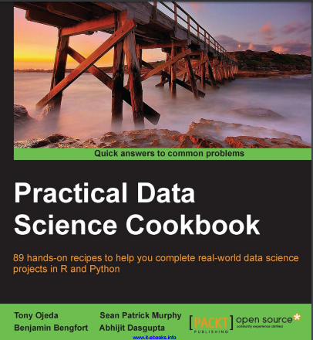
经典文献选读
▼专题【案例与实践】
►8.如何继续学习
Preparing Your Data Science Environment
Driving Visual Analysis with Automobile Data
Simulating American Football Data
Modeling Stock Market Data
Visually Exploring Employment Data
Creating Application-oriented Analyses Using Tax Data
Driving Visual Analyses with Automobile Data
Working with Social Graphs
Recommending Movies at Scale
Harvesting and Geolocating Twitter Data
Optimizing Numerical Code with NumPy and SciPy

Slide 8


经典文献选读
▼专题【案例与实践】
►8.如何继续学习
haven: Import and Export 'SPSS', 'Stata' and 'SAS' Files
forcats: Tools for Working with Categorical Variables (Factors)
purrr: Functional Programming Tools

Slide 9
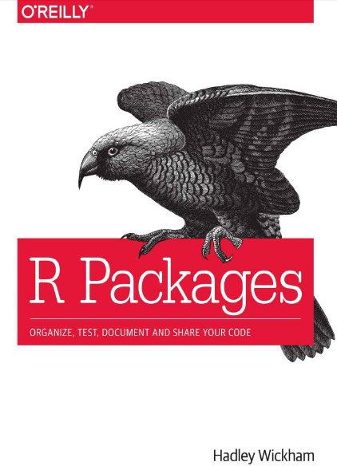
经典文献选读
▼专题【案例与实践】
►8.如何继续学习
Chapter 4 Package Metadata
Chapter 5 Object Documentation
Chapter 6 Vignettes: Long-Form Documentation
Chapter 7 Testing
Chapter 8 Namespace
Chapter 9 External Data
Chapter 10 Compiled Code
...
Chapter 15 Releasing a Package

Slide 10
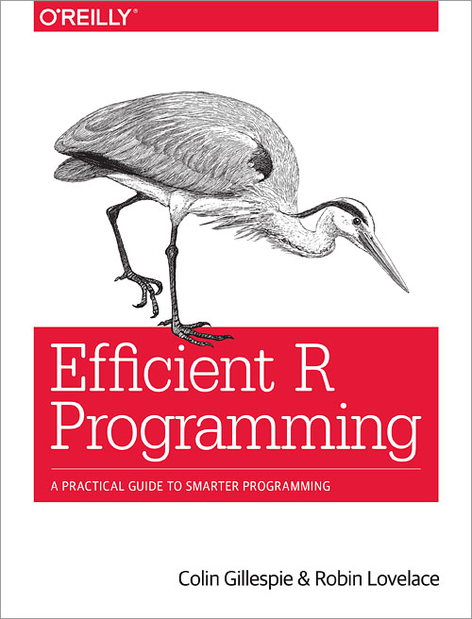
经典文献选读
▼专题【案例与实践】
►8.如何继续学习
Colin Gillespie is Senior lecturer (Associate professor) at Newcastle University, UK. His research interests are high-performance computing and Bayesian statistics. He is regularly employed as a consultant by Jumping Rivers and has been teaching R since 2005.
Robin Lovelace is a researcher at the Leeds Institute for Transport Studies (ITS) and the Leeds Institute for Data Analytics (LIDA). Robin has many years using R for academic research and has taught numerous R courses at all levels. He has developed a number of popular R resources, including Introduction to Visualising Spatial Data in R and Spatial Microsimulation with R (Lovelace and Dumont 2016). These skills have been applied on a number of projects with real-world applications, including the Propensity to Cycle Tool, a nationally scalable interactive online mapping application and the stplanr package.

Slide 11
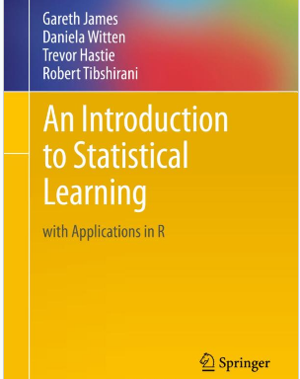
经典文献选读
▼专题【案例与实践】
►8.如何继续学习
R+
统计学+
机器学习

Slide 12
经典文献选读
▼专题【案例与实践】
►8.如何继续学习
Working with Different Types of Data in R
Managing Data Structures in R
Importing, Scraping, and Exporting Data with R
Creating Efficient & Readable Code in R
Shaping & Transforming Your Data with R

Slide 13



▼专题【案例与实践】
►结束
数据科学理论与实践
朝乐门
清华大学出版社
2017
数据科学
朝乐门
清华大学出版社
2016
chaolemen
@
ruc.edu.cn
参考书目
教学支撑平台
主讲人联系方式
主讲人微信

